Slide 1


GBME Probability and Statistics | Fall 2018
Lecture 01 | 090318
Lecture 01
Course overview, Statistics?
CHOONG-WAN WOO | COCOAN lab | http://cocoanlab.github.io

Slide 2
Lecture 01 | 090318
Hi everyone,
Look around.
Meet your classmates.
Let’s introduce yourself!
Name?
Which department?
What year are you in?
What is your study interest?
What is your career goal?
CHOONG-WAN WOO | COCOAN lab | http://cocoanlab.github.io

Slide 3
Lecture 01 | 090318
Hi everyone,
One more round!
Any experience in stats, data analysis, data science?
What do you want to learn from the class?
Let’s collect some data!
How many hours did you sleep last night?
How many do you sleep on average?
CHOONG-WAN WOO | COCOAN lab | http://cocoanlab.github.io

Slide 4
Lecture 01 | 090318
Course overview
GBME’s Probability and Statistics
Class code: GBE 3037
Intro Stats
My first stat class at SKKU
Textbook: "Stats: Data and Models" by De Veaux, Velleman, and Bock, Fourth Edition
Third edition also works!
CHOONG-WAN WOO | COCOAN lab | http://cocoanlab.github.io

Slide 5
Lecture 01 | 090318
Course overview
GBME’s Probability and Statistics
Class code: GBE 3037
Intro Stats
My first stat class at SKKU
Textbook: "Stats: Data and Models" by De Veaux, Velleman, and Bock, Fourth Edition
Third edition also works!
You can get free PDF of the third edition:
https://acwang.files.wordpress.com/2015/08/stats-data-and-models-3rd-edition-richard-d-de-veaux.pdf
Two useful web-based platforms for the class:
GitHub for posting class-related materials, assignments, data, codes, etc
Piazza for class-related discussion and questions
CHOONG-WAN WOO | COCOAN lab | http://cocoanlab.github.io

Slide 6
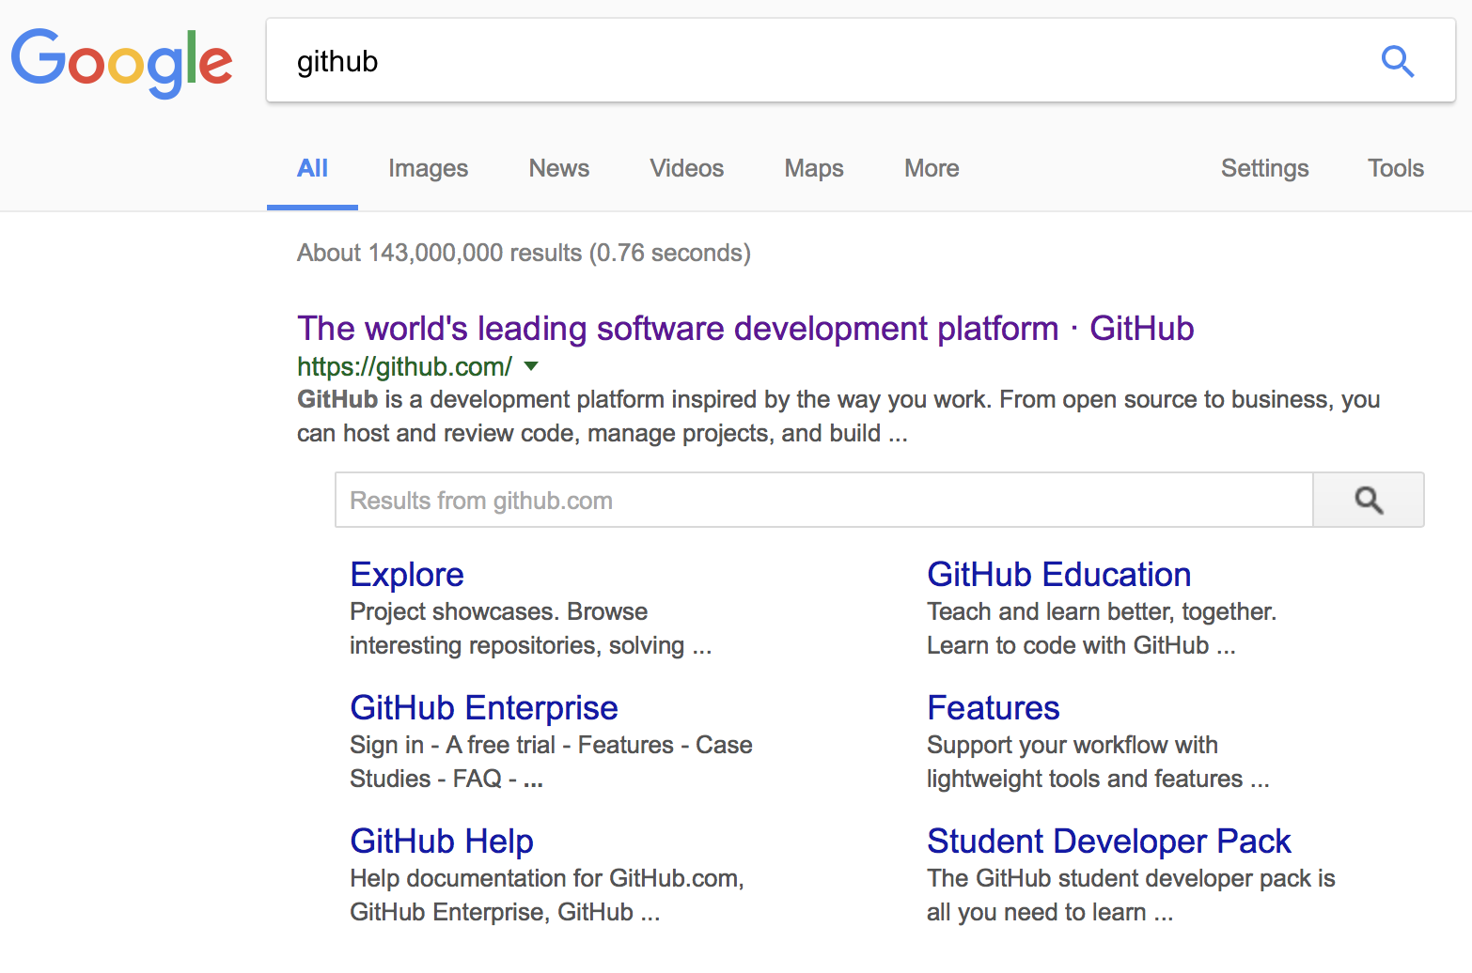
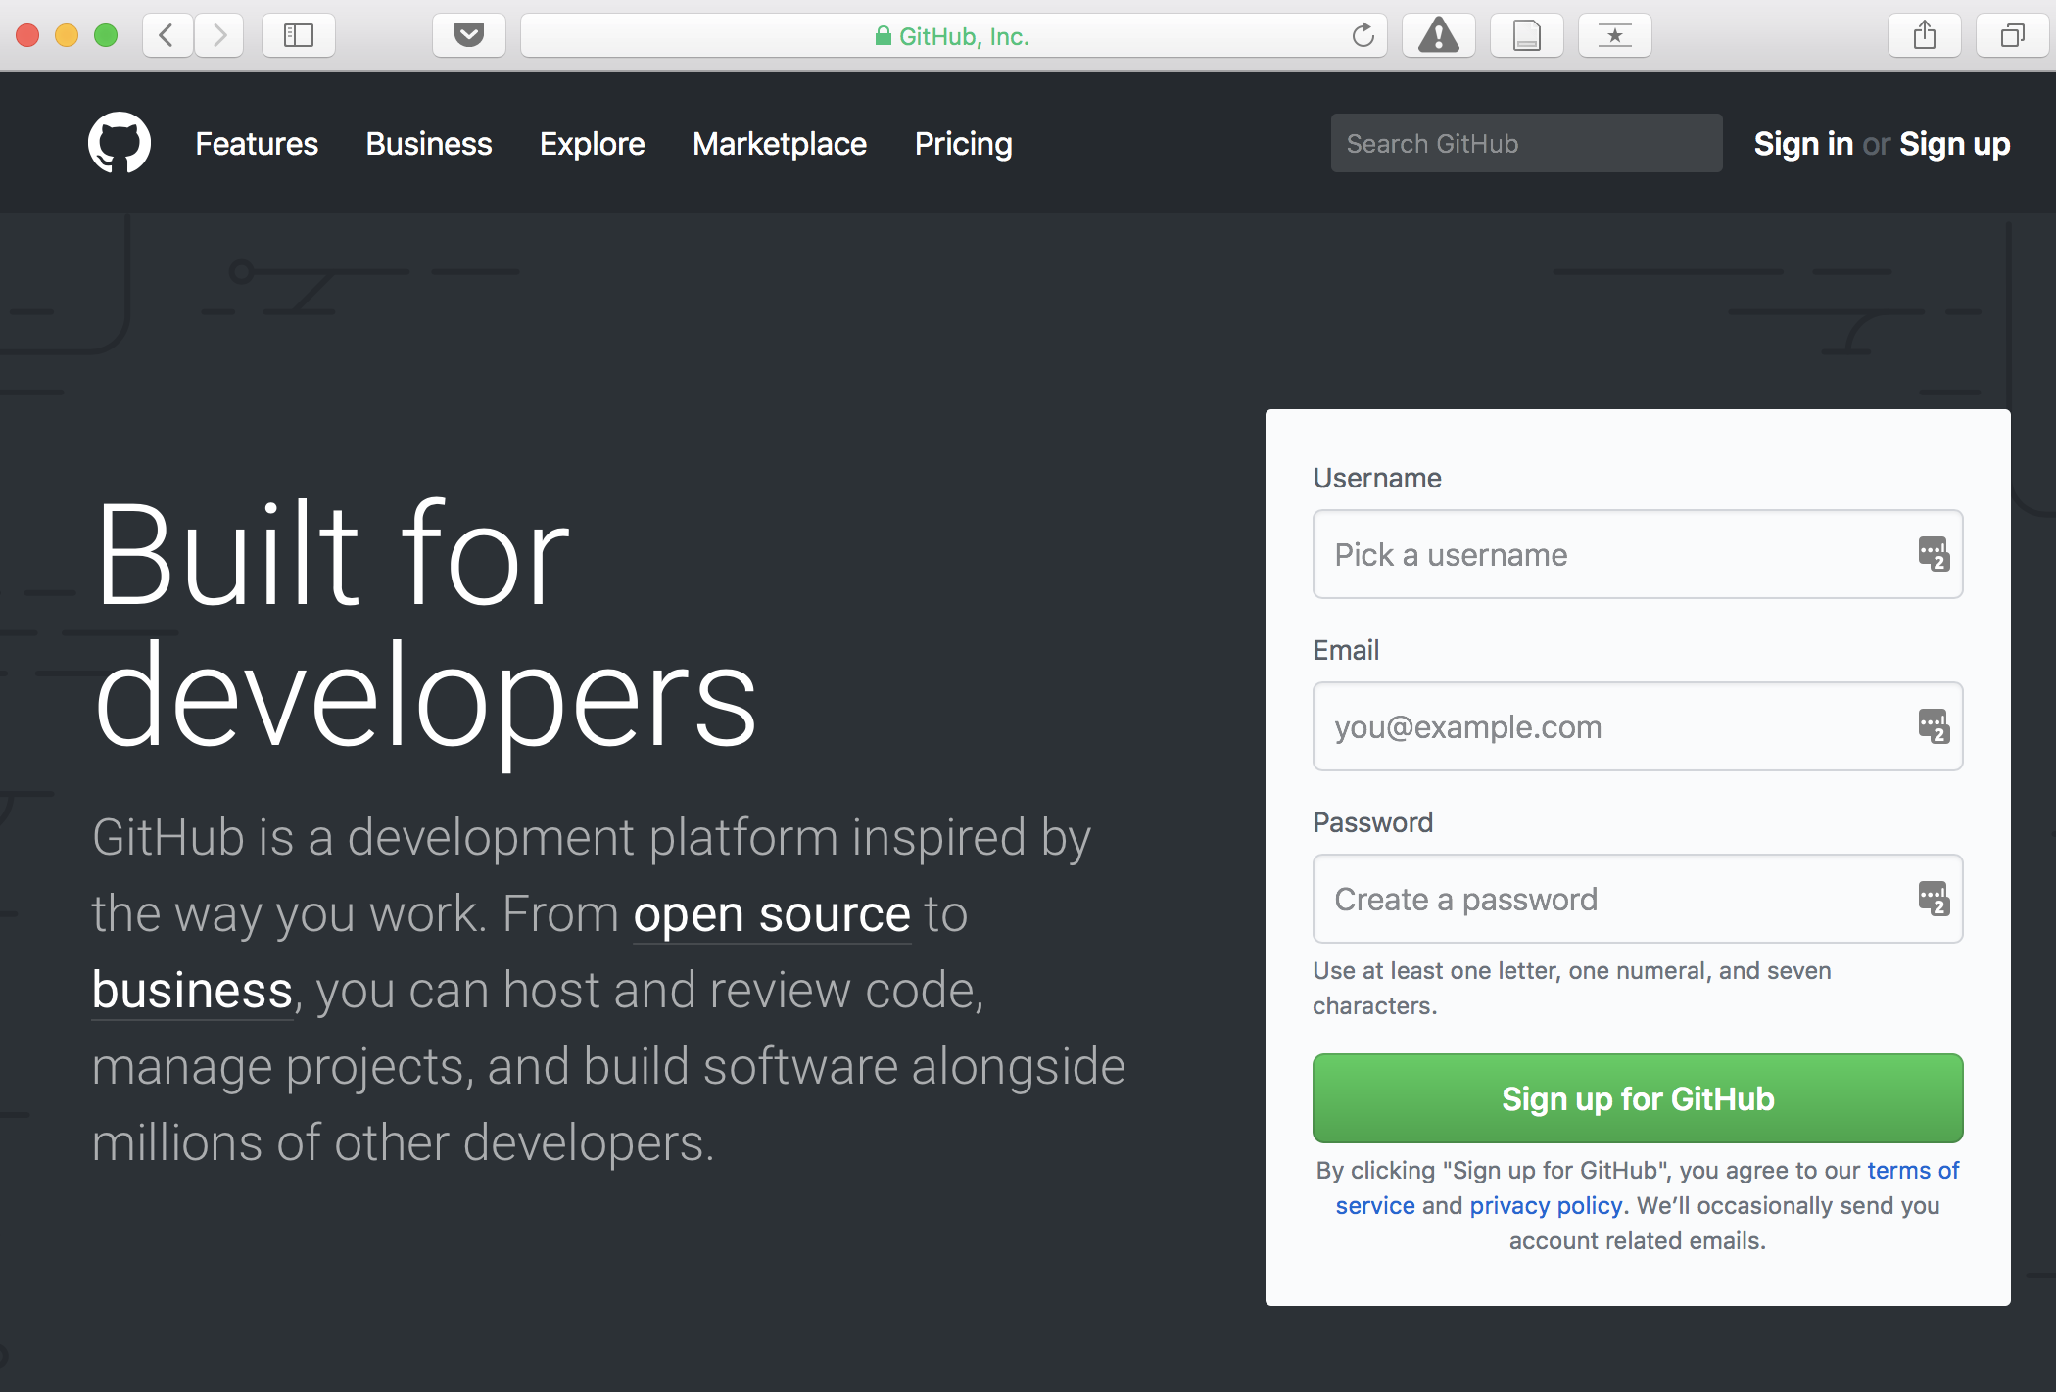
Lecture 01 | 090318
Most popular software development platform: version control, easy-sharing scripts and data, etc.
CHOONG-WAN WOO | COCOAN lab | http://cocoanlab.github.io

Slide 7
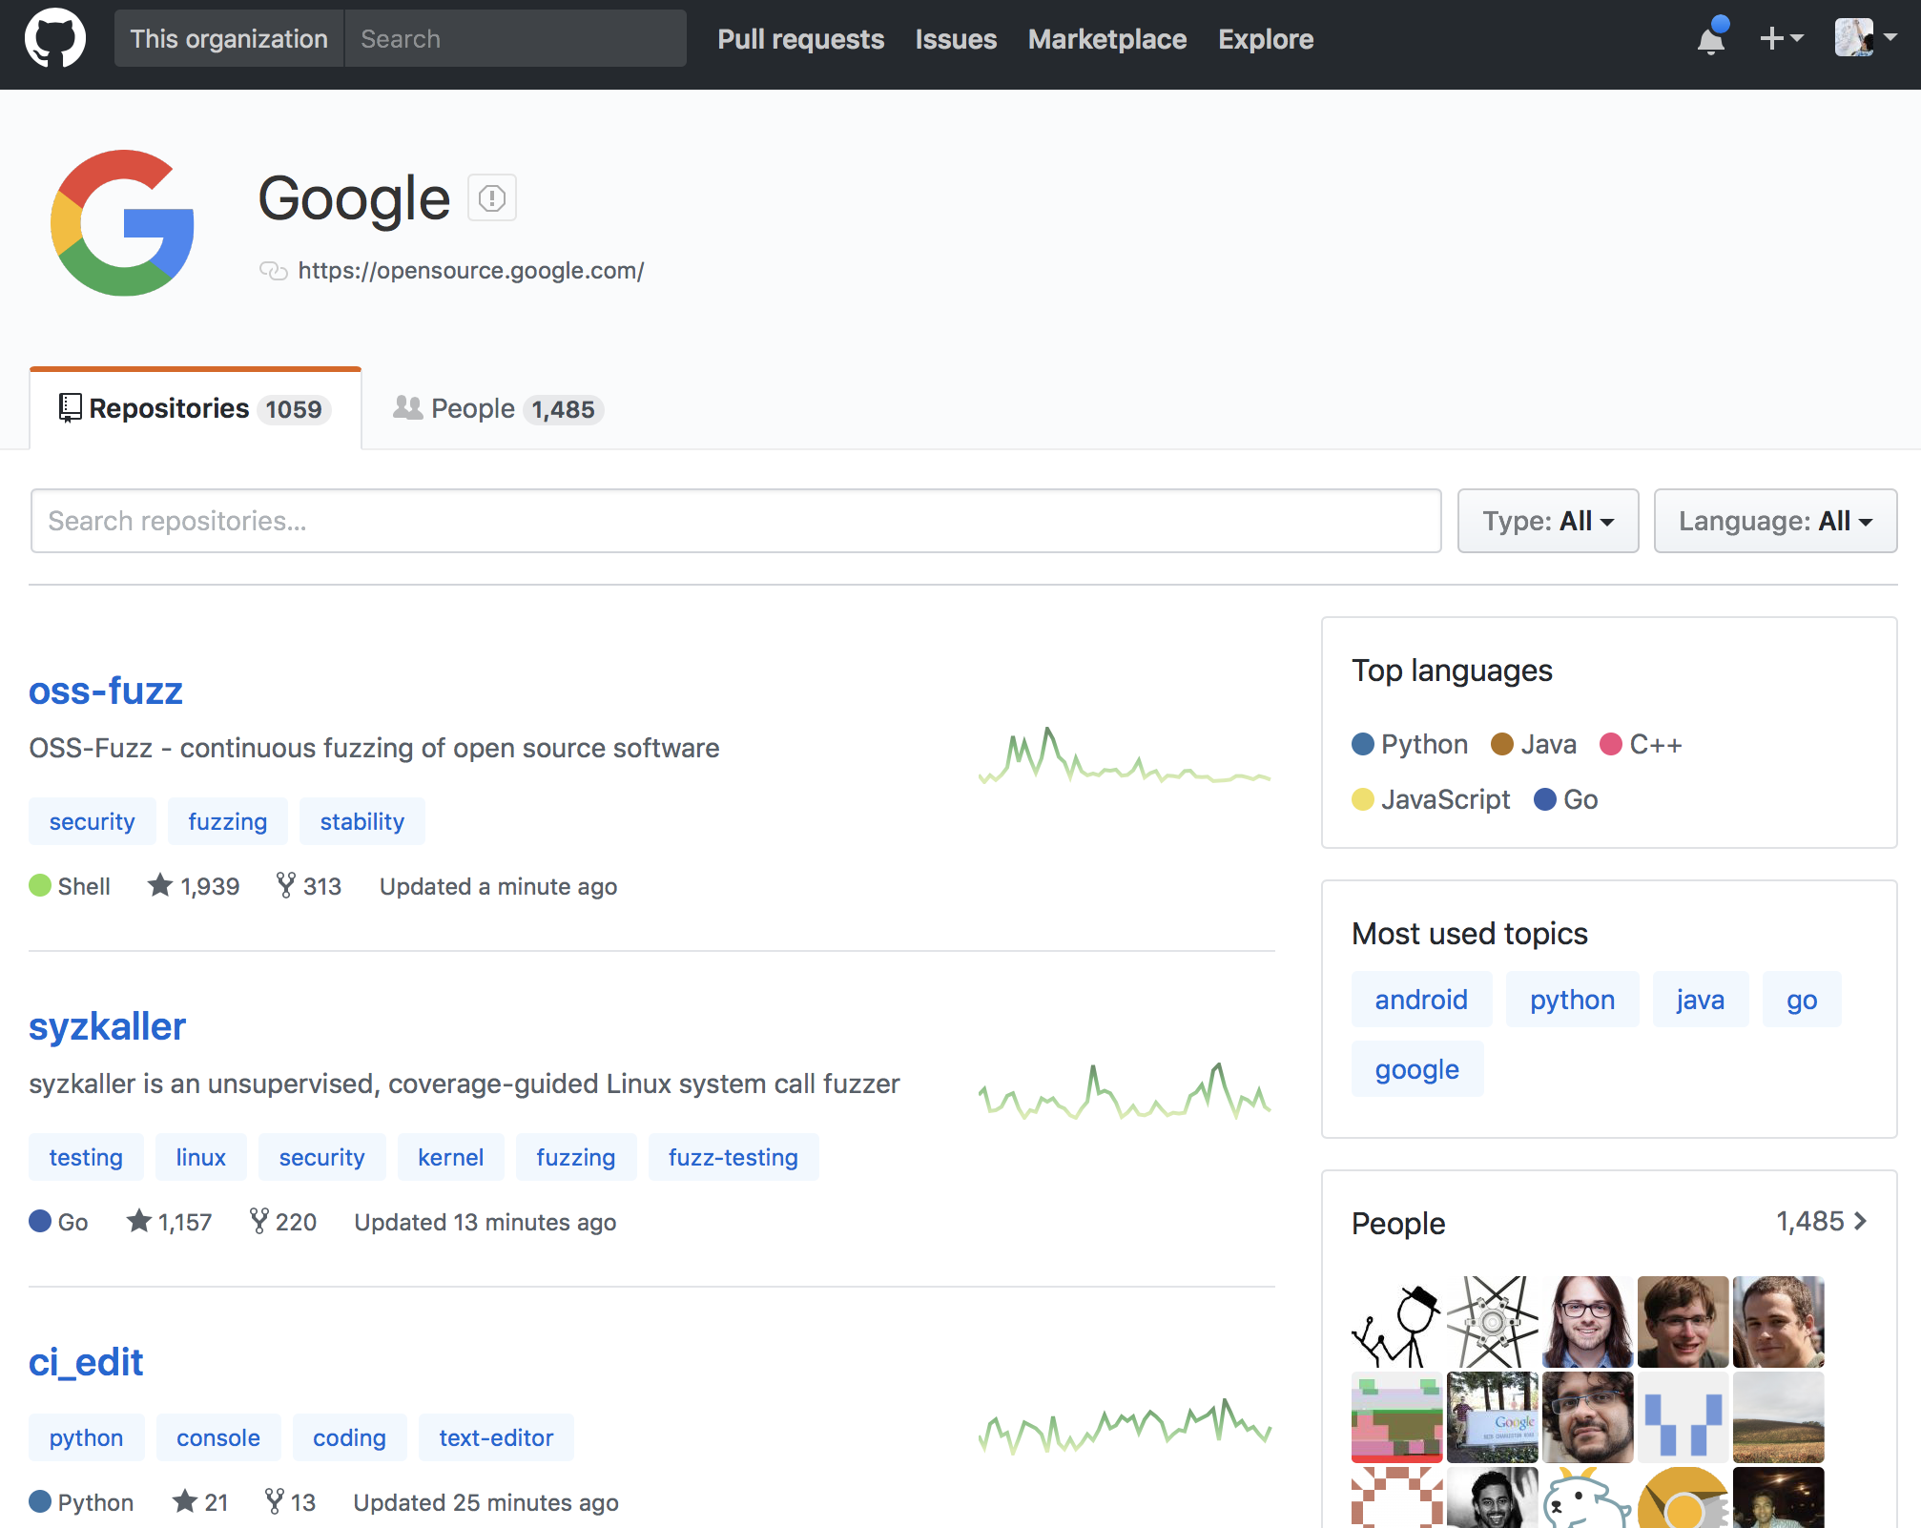
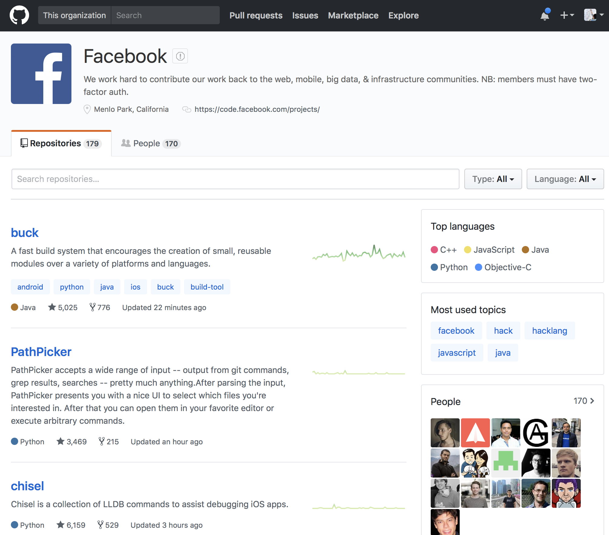
Lecture 01 | 090318
Most popular software development platform: version control, easy-sharing scripts and data, etc.
Everyone uses GitHub for the development, including Google, Facebook, etc.
CHOONG-WAN WOO | COCOAN lab | http://cocoanlab.github.io

Slide 8
Lecture 01 | 090318
Most popular software development platform: version control, easy-sharing scripts and data, etc.
Everyone uses GitHub for the development, including Google, Facebook, etc.
More and more people are creating and sharing a GitHub repository for their research and publications:
CHOONG-WAN WOO | COCOAN lab | http://cocoanlab.github.io

Slide 9
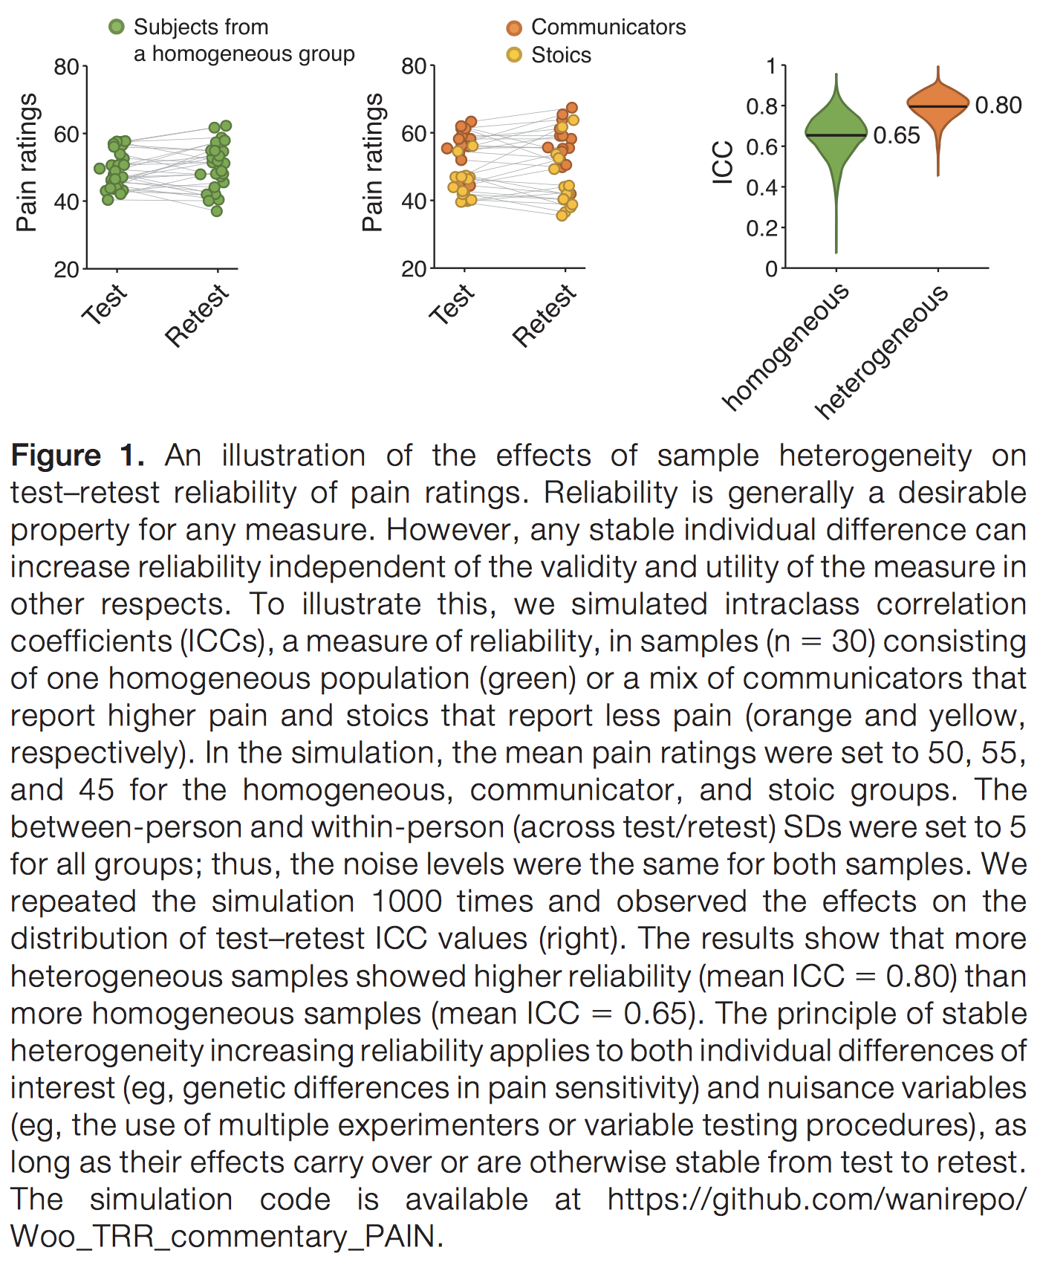
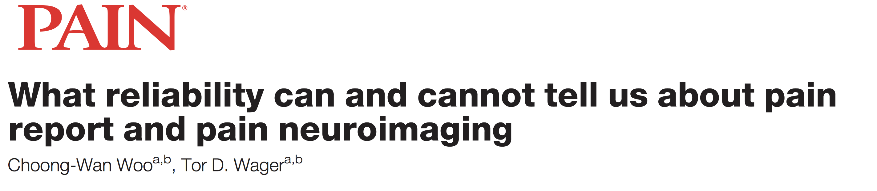
Lecture 01 | 090318
Most popular software development platform: version control, easy-sharing scripts and data, etc.
Everyone uses GitHub for the development, including Google, Facebook, etc.
More and more people are creating and sharing a GitHub repository for their research and publications:
E.g., Woo & Wager, 2016, PAIN
CHOONG-WAN WOO | COCOAN lab | http://cocoanlab.github.io

Slide 10
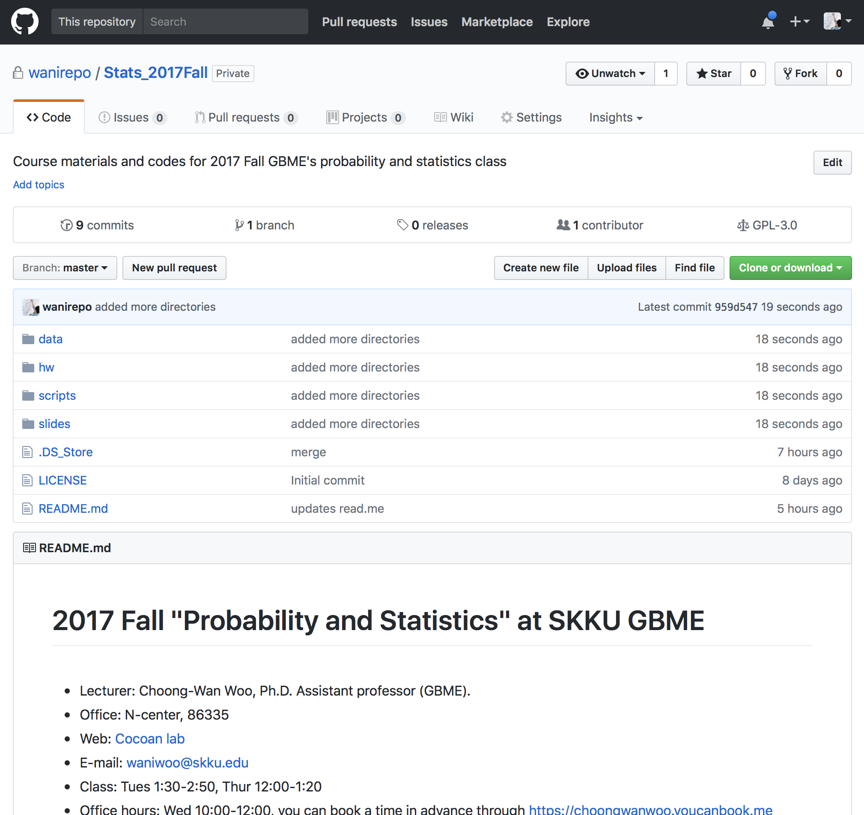
Lecture 01 | 090318
Our class website: https://github.com/wanirepo/Stats_2018Fall
README.md is the syllabus.
Let’s visit the website, and read the syllabus.
CHOONG-WAN WOO | COCOAN lab | http://cocoanlab.github.io

Slide 11
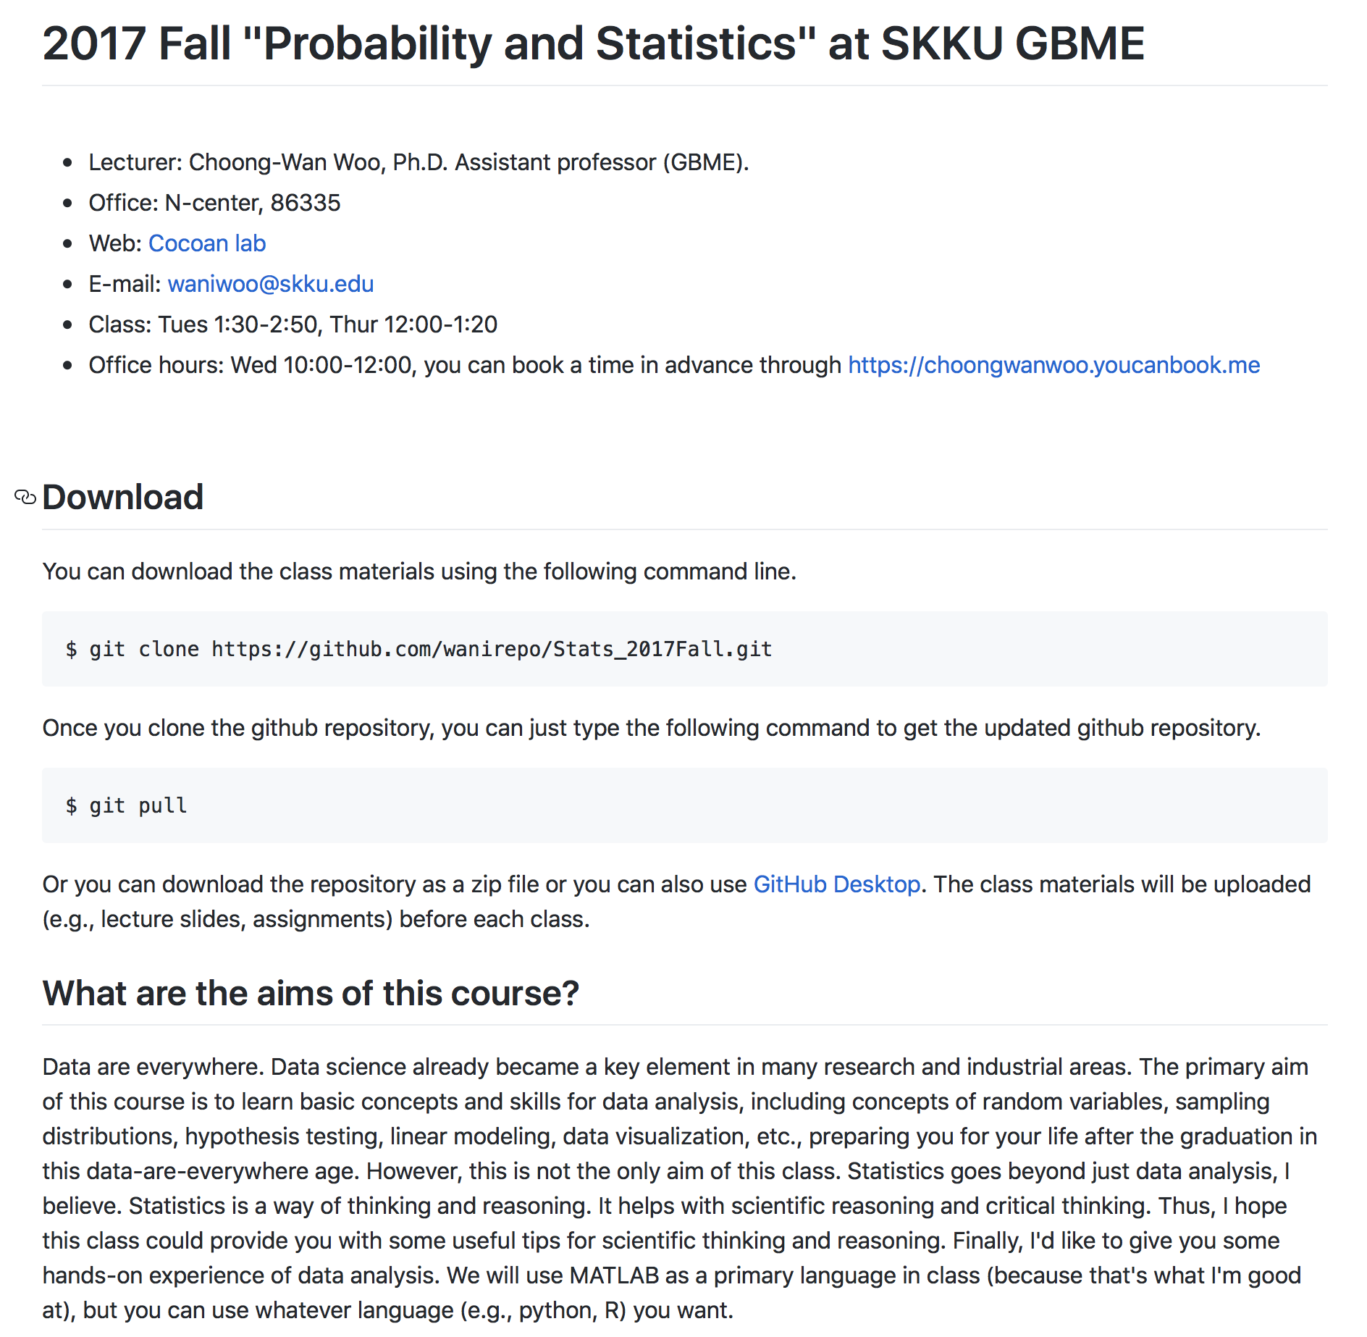
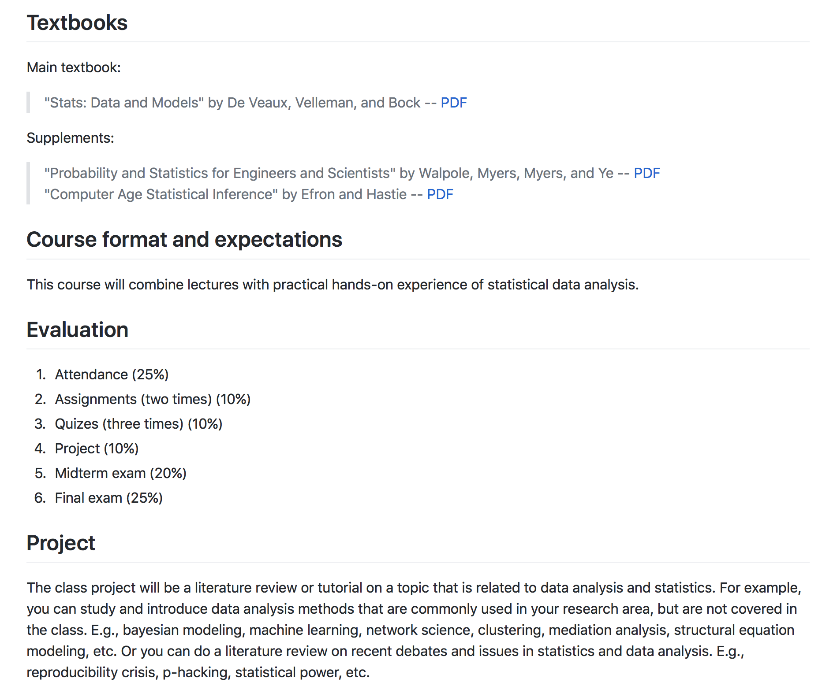
Lecture 01 | 090318
https://github.com/wanirepo/Stats_2018Fall/blob/master/README.md
CHOONG-WAN WOO | COCOAN lab | http://cocoanlab.github.io

Slide 12
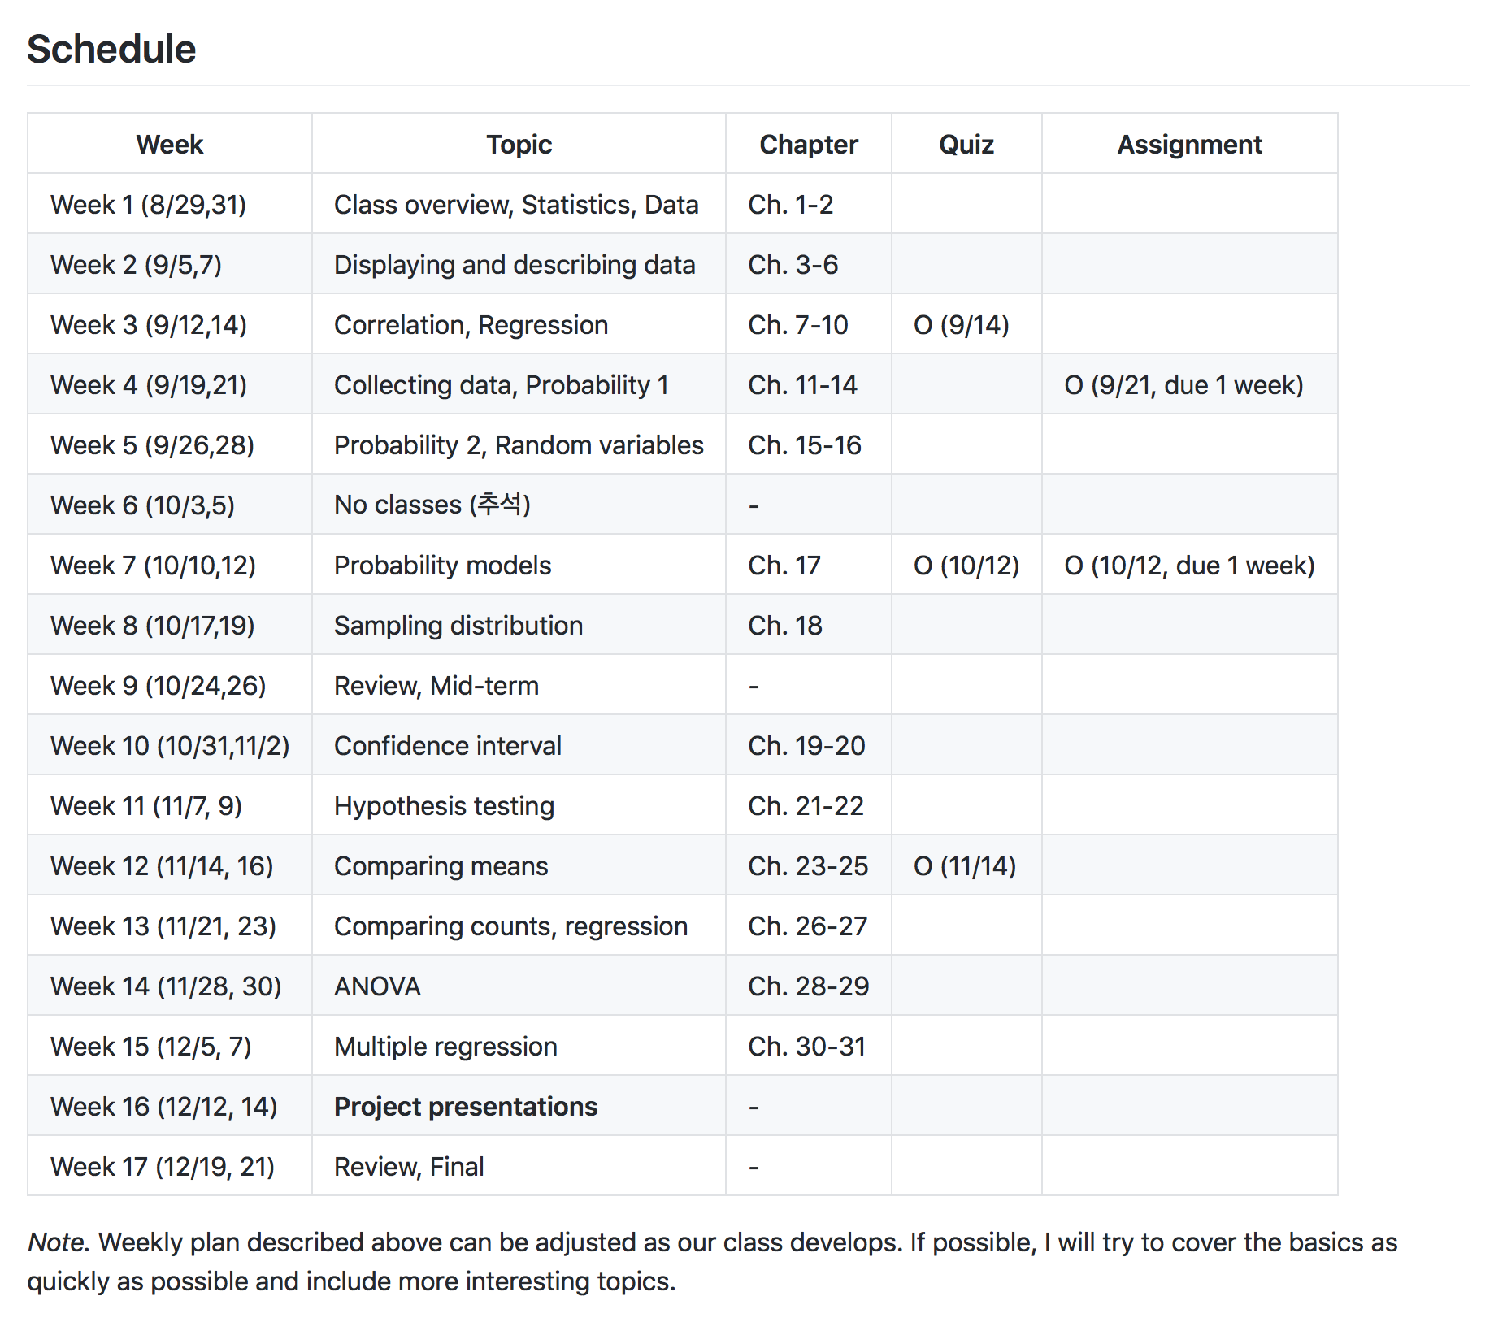
Lecture 01 | 090318
https://github.com/wanirepo/Stats_2017Fall/blob/master/README.md
Please note that: this schedule is tentative, and can be adjusted as our class develops. If possible, I will try to talk about more interesting topics in the class.
CHOONG-WAN WOO | COCOAN lab | http://cocoanlab.github.io

Slide 13
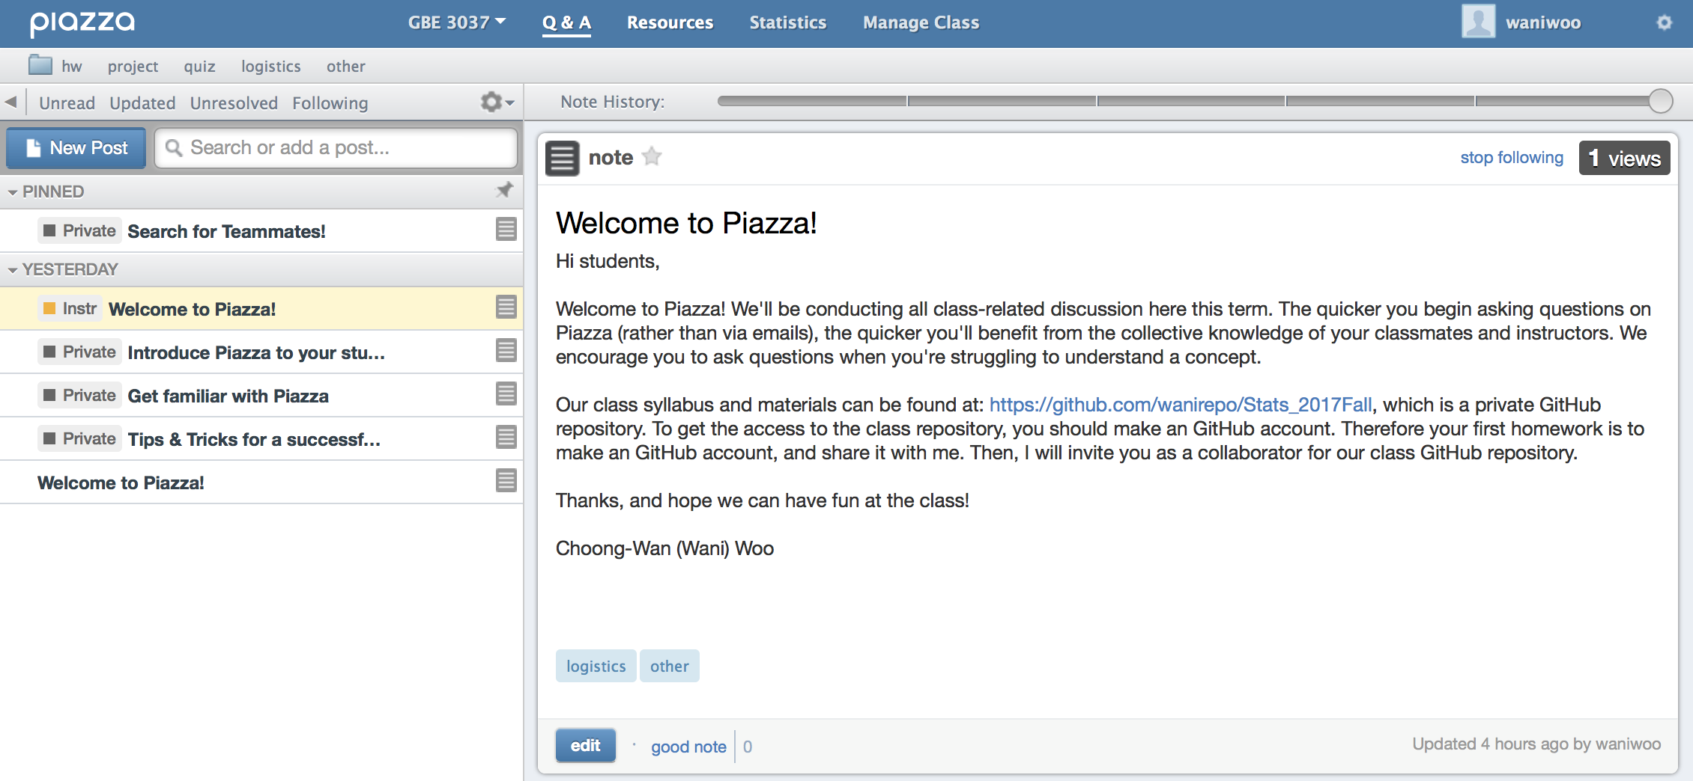
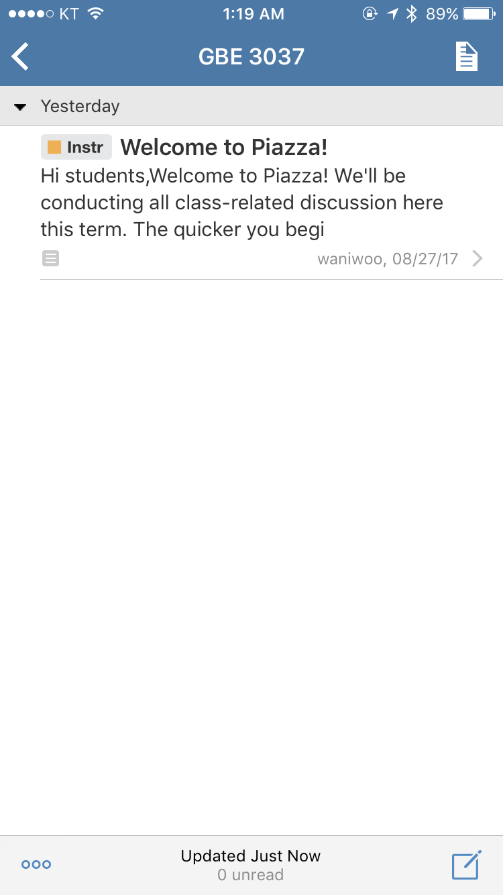
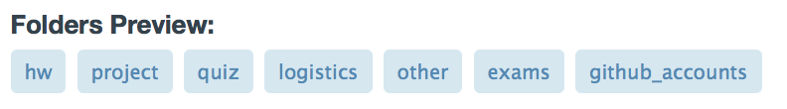
Lecture 01 | 090318
A great platform for class-related discussions and questions.
You can sign up for the class here: https://piazza.com/sungkyunkwan_university/fall2017/gbe3037
Desktop version
Mobile version
CHOONG-WAN WOO | COCOAN lab | http://cocoanlab.github.io

Slide 14
Lecture 01 | 090318
To-do before the next class
Sign up for GitHub and Piazza
Share your GitHub accounts through Piazza with the tag (or folder)
Download the textbook PDF! and read the first two chapters.
https://acwang.files.wordpress.com/2015/08/stats-data-and-models-3rd-edition-richard-d-de-veaux.pdf
CHOONG-WAN WOO | COCOAN lab | http://cocoanlab.github.io

Slide 15
Lecture 01 | 090318
Statistics
“Statistics is about asking questions and using data to understand the answers.” (Tor D. Wager)
Professor, Psychology and Neuroscience, University of Colorado Boulder
My PhD and postdoc advisor
CHOONG-WAN WOO | COCOAN lab | http://cocoanlab.github.io

Slide 16
Lecture 01 | 090318
Statistics
“Statistics is about asking questions and using data to understand the answers.” (Tor D. Wager)
“Statistics is the science of collecting, analyzing and interpreting data, or factual information.” (Martin A. Lindquist)
Professor, Biostatistics, Johns Hopkins University
Tor’s good friend and colleague, something like a co-advisor for me.
CHOONG-WAN WOO | COCOAN lab | http://cocoanlab.github.io

Slide 17
Lecture 01 | 090318
Statistics
“Statistics is about asking questions and using data to understand the answers.” (Tor D. Wager)
“Statistics is the science of collecting, analyzing and interpreting data, or factual information.” (Martin A. Lindquist)
“Statistics is a way of reasoning, along with a collection of tools and methods, designed to help us understand the world.” (Textbook)
Statistics is becoming more and more important. Why??
CHOONG-WAN WOO | COCOAN lab | http://cocoanlab.github.io

Slide 18

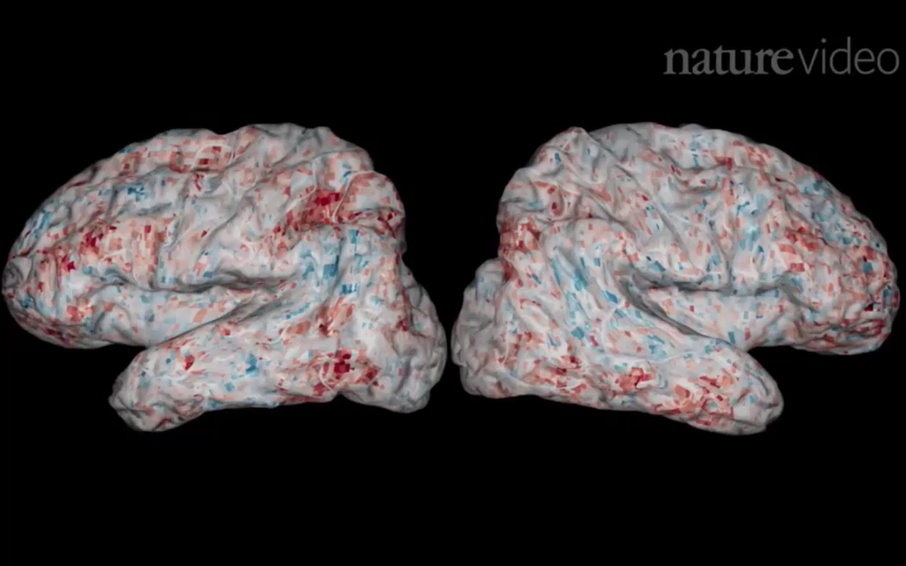
Lecture 01 | 090318
Big data era!
Light-sheet microscopy: a larval zebrafish
Functional Magnetic Resonance Imaging
One-hour scan yields 1TB data.
fMRI: whole-brain scan in 460ms with 2 mm³ resolution
Videos from Freeman et al., 2014, Nat Methods; Huth et al., 2016, Nature
CHOONG-WAN WOO | COCOAN lab | http://cocoanlab.github.io

Slide 19
Lecture 01 | 090318
Big data era! What’s the challenge?
Jeremy Freeman
Previously, Janelia Farm Research Campus
Currently, Chan-Zuckerberg Science Initiative
New technologies are now, finally, allowing us to probe
the activity of thousands of neurons simultaneously
while animals perform rich, ethologically relevant behaviors…
The first challenge to converting this newfound torrent of
neural measurement into fundamental scientific meaning is
to ask how to “make sense of the data.”
Statistics!!!
CHOONG-WAN WOO | COCOAN lab | http://cocoanlab.github.io

Slide 20
Lecture 01 | 090318
Statistics
“Statistics is about asking questions and using data to understand the answers.” (Tor D. Wager)
“Statistics is the science of collecting, analyzing and interpreting data, or factual information.” (Martin A. Lindquist)
“Statistics is a way of reasoning, along with a collection of tools and methods, designed to help us understand the world.” (Textbook)
Statistics is a scientific way of searching for “meaning” out of data. (Choong-Wan Woo)
CHOONG-WAN WOO | COCOAN lab | http://cocoanlab.github.io

Slide 21
Lecture 01 | 090318
Statistics
The problem is people see only what they want to see! and statistics can serve as a lens to filter data!
From Martin’s slides:
Three types of lies: Lies, damn lies and statistics.
Always approach statistics with a critical eye.
From Tor’s slides:
“You can say anything with statistics”
Statistics don’t lie, but people can lie with statistics
CHOONG-WAN WOO | COCOAN lab | http://cocoanlab.github.io

Slide 22
Lecture 01 | 090318
A statistician’s manifesto
(From T. Hastie, via J. McAuliffe, via Jordan Boyd-Graber)
Understand the ideas behind the statistical methods, so you know how to use them, when to use them, when not to use them.
Complicated methods build on simple methods. Understand simple methods first.
The results of a method are of little use without an assessment of how well or poorly it is doing.
CHOONG-WAN WOO | COCOAN lab | http://cocoanlab.github.io

Slide 23
Lecture 01 | 090318
To-do before the next class
Sign up for GitHub and Piazza
Share your GitHub accounts through Piazza with the tag (or folder)
Download the textbook PDF! and read the first two chapters.
https://acwang.files.wordpress.com/2015/08/stats-data-and-models-3rd-edition-richard-d-de-veaux.pdf
CHOONG-WAN WOO | COCOAN lab | http://cocoanlab.github.io

